Slide 1

Long Term Company Growth Prediction using NLP Techniques on 10-K Financial Filings
Hou Yongzhuo, Yang Lixuan, Li Hongzhe, Wang Zhiliang, Lu Yuliang
FT 5005 Final Project Presentation, AIDF & SoC, NUS
April 24, 2022

Slide 2


Table of Contents
01
02
03
Introduction
Dataset Summary
Target Variable Construction
04
05
06
Feature Summary
Feature Engineering
Model & Result
07
Conclusion

Slide 3

Introduction
01

Slide 4
Exploring
Estimating
Directing
Motivating
Research Topic
Forecasting yield of a firms depends
on annual Form 10-K SEC filing,
stock prices and key statistics from financial statements.
Estimating the likelihood of an upcoming status and long-term growth of firms and industries
Giving investors insights to inform and modify their trading decesions.
Potential Applications:
Robo Advisor
Platform that justification for stock recommendations.

Slide 5

Dataset Summary
02

Slide 6
Sample Size
Company Counts
Time Periods
5396
467
2005-2020
Dataset Size
The number of rows of our dataset
The number of companies in our dataset
The filing time of document files in our dataset

Slide 7

Data Sources
It includes daily stock prices data for each company in our dataset.
It categorizes the industries that companies belong to based on business activities
They provide tools for tokenizing texts and doing advanced sentiment analysis.
Daily Stock Prices
SIC Codes
LM & Harvard IV-4 Dictionary
10-K Filings:
Risk Factors
10-K Filings:
Item.1 Business
10-K Filings:
Item.7 MD&A
It describes the potential future failures and risks for investors and potential investors.
It describes the business of the company, mostly about the business structure.
It discusses the operational issues of the resulting business outcomes.

Slide 8

Target Variable Construction
03

Slide 9

Target Variable Choices
Ideal Target Variable
Proxy Variable of the Long-term Company Prediction Growth
Choices
Long-term Moving
Average Stock Returns
Long-term Cumulative Abnormal Stock Returns (CARs)
It measures simple average returns between current time and a period of time in the future.
It measures the sum of divergence between actual stock prices with the expected stock prices using the asset pricing models, CAPM in our project.
Final Choice
Our final Y is class 0 or 1, where 1 indicates the CAR is positive, and 0 indicates the CAR is negative.

Slide 10
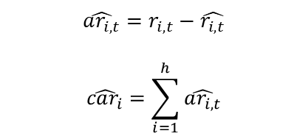

Target Variable Construction
We apply the idea of sliding window approach in the time series model to contruct our target Y.
We use the CAPM model to estimate the expected stock returns, where we use the S&P 500 index as the market index.
We estimate α & β using the market index and individual stock prices during the lookback periods.
We use the estimated α & β to calculate individual expected stock prices during the horizon periods.
The sum of difference between actual stock prices and the expected stock prices is the CAR. Formulas are:
The lookback periods
(1 year)
Customized Sliding Window
The gap periods
(1 month)
$$r_{i,t}=α+βr_{m,t}+ϵ_{i, t}$$
$$\hat{r_{i,t}}=\hat{α}+\hat{β}r_{m,t}$$
$$\hat{ar_{i,t}}=r_{i,t}−\hat{r_{i,t}}$$
$$\hat{car_{i}}=\sum_{i=1}^{h}{\hat{ar_{i,t}}}$$
The horizon periods
(2 years)

Slide 11
Target Y Construction
 | Mean | Std.Dev
Total Class | 0.193 | 0.742
Class 0 | -0.130 | 0.318
Class 1 | 0.323 | 0.604
CAR Summary
Binary Y Distribution

Slide 12

Feature Summary
04

Slide 13
Raw & Processed Data
Variable Name | Raw Data | Processed Data
SIC Code | 3317 | [0,0,1,0,0,0,0,0]
Sample Risk Factor Texts | A downturn in government spending related to public water transmission projects would adversely affect our business | ['downturn', 'govern', 'spend', 'relat', 'public', 'transmiss', 'project', 'advers', 'affect', 'busi']
Sample Item1.Business Texts | Item 1. Business We are a leading North American manufacturer of large-diameter, high-pressure steel pipeline systems for use in water infrastructure applications. | ['item', 'busi', 'lead', 'manufactur', 'largediamet', 'highpressur', 'pipelin', 'system', 'use', 'infrastructur', 'applic']
Sample Item7.MD&A Texts | Table of Contents Item 7. Management s Discussion and Analysis of Financial Condition and Results of Operations Forward-Looking Statements | ['tabl', 'content', 'item', 'manag', 's', 'discuss', 'analysi', 'financi', 'condit', 'result', 'oper', 'forwardlook', 'statement']

Slide 14

Feature Engineering
05

Slide 15
Feature Construction
Volatility Benchmark
WTI Crude Oil Futures
CL=F
Statistical
Distance
“Kitchen Sink”
Combination Approach
Volatility
Benchmark
CBOE Volatility Index
^VIX
S&P 500 Index
^GSPC
[1] X. D. J. K. Zhifeng Dai, Huiting Zhou, “Forecasting stock market volatility: A combination approach,” Discrete Dynamics in Nature and Society, p. 9, 2020.
[2] R. F. Engle, E. Ghysels, and B. Sohn, “Stock market volatility and macroeconomic fundamentals,” Review of Economics and Statistics, vol. 95, no. 3, pp. 776–797, 2013.
[3] C. Conrad and K. Loch, “Anticipating long term stock market volatility,” Journal of Applied Econometrics, vol. 30, no. 7, pp. 1090–1114, 2015.

Slide 16
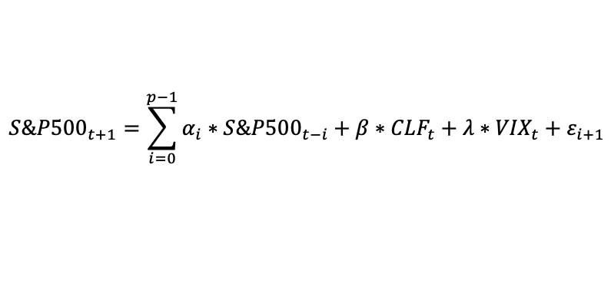
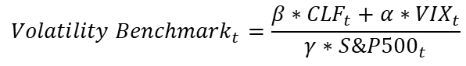
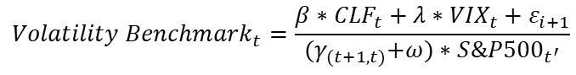
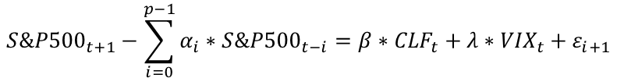
Feature Construction
$${S\&P500}_{t+1}=\sum_{i=0}^{p−1}{α_{i}}∗{S\&P500}_{t−i}+β∗{CLF}_{t}+λ∗{VIX}_{t}+ε_{i+1}$$
Position exchange
Volatility Benchmark
$${S\&P500}_{t+1}−\sum_{i=0}^{p−1}{α_{i}}∗{S\&P500}_{t−i}=β∗{CLF}_{t}+λ∗{VIX}_{t}+ε_{i+1}$$
Time | CL=F | ^VIX | ^GSPC | Volatility
2005 | 0.286447 | 0.07971 | 0.114262 | 0.031378
2006 | 0.444805 | 0.079597 | 0.159729 | 0.062822
2007 | 0.546119 | 0.298934 | 0.233175 | 0.147784
2008 | 1 | 1 | 0.120329 | 0.180493
2009 | 0.37467 | 0.947119 | 1.00E-06 | 9.91E-07
2010 | 0.666244 | 0.531263 | 0.084579 | 0.075963
2011 | 0.923109 | 0.606933 | 0.140848 | 0.161627
2012 | 0.908416 | 0.311129 | 0.190078 | 0.173857
2013 | 0.971571 | 0.146314 | 0.306193 | 0.256716
2014 | 0.887109 | 0.142945 | 0.433111 | 0.334596
2015 | 0.15503 | 0.259429 | 0.490384 | 0.152433
2016 | 0.066005 | 0.220052 | 0.505094 | 0.108364
2017 | 0.189423 | 1.00E-06 | 0.661314 | 0.093951
2018 | 0.42313 | 0.257376 | 0.792209 | 0.404328
2019 | 0.291278 | 0.201151 | 0.865131 | 0.319512
2020 | 1.00E-06 | 0.839438 | 1 | 0.629579
Merge
$${{(γ}_{(t+1,t)}+ω)∗S\&P500}_{t^{′}}=β∗{CLF}_{t}+λ∗{VIX}_{t}+ε_{i+1}$$
As numerator
As denominator
$${Volatility Benchmark}_{t}=\frac{β∗{CLF}_{t}+λ∗{VIX}_{t}+ε_{i+1}}{{{(γ}_{(t+1,t)}+ω)∗S\&P500}_{t^{′}}}$$
Convert
$${Volatility Benchmark}_{t}=\frac{β∗{CLF}_{t}+α∗{VIX}_{t}}{{γ∗S\&P500}_{t}}$$
Statistical
Distance
Init: 0.3
Init: 0.4
Init: 0.3
[1] X. D. J. K. Zhifeng Dai, Huiting Zhou, “Forecasting stock market volatility: A combination approach,” Discrete Dynamics in Nature and Society, p. 9, 2020.
[2] R. F. Engle, E. Ghysels, and B. Sohn, “Stock market volatility and macroeconomic fundamentals,” Review of Economics and Statistics, vol. 95, no. 3, pp. 776–797, 2013.
[3] C. Conrad and K. Loch, “Anticipating long term stock market volatility,” Journal of Applied Econometrics, vol. 30, no. 7, pp. 1090–1114, 2015.

Slide 17
Feature Construction
Efficient Market Hypothesis
The Wisdom of Crowds
Market Reaction
Event Study
Post-Event Window
t1’
T1
T1
t1
Event
(t=0)
t2
Estimation Window
Event Observation Window
40 trading days
252 trading days
[1] B. G. Malkiel, “Efficient market hypothesis,” Finance, pp. 127–134, 1989.
[2] S. D. S. Pu Liu and A. A. Syed, “Stock price reactions to the wall street journal’s securities recommendations,” The Journal of Financial and Quantitative Analysis, vol. 25, no. 3, p. 12, 1990. [3] J. Surowiecki, “The wisdom of crowds,” p. 7, 2005

Slide 18
Feature Construction
Efficient Market Hypothesis
The Wisdom of Crowds
Market Reaction
Event Study
Event Type | Time Slot
Around The Event | [-1,+1]
 | [0,+1]
Day-by-day | [-1]
 | [0]
 | [1]
Post Event | [2,5]
 | [2,10]
 | [2,20]
Pre Event | [-5,-2]
 | [-10,-2],
 | [-20,-2]
Cumulative Abnormal Returns (CARs)
Positive
Zero
Negative
Counter
Proximate Effectiveness
Independent Sample T-test
[1] B. G. Malkiel, “Efficient market hypothesis,” Finance, pp. 127–134, 1989.
[2] S. D. S. Pu Liu and A. A. Syed, “Stock price reactions to the wall street journal’s securities recommendations,” The Journal of Financial and Quantitative Analysis, vol. 25, no. 3, p. 12, 1990. [3] J. Surowiecki, “The wisdom of crowds,” p. 7, 2005

Slide 19
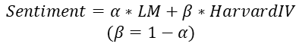
Feature Construction
Dictionary-based
pysentiment
Lydia System Calculation
Loughran & McDonald
10-K Financial Filings
Positive
Polarity
+
Harvard-IV
$$Sentiment=α∗LM+β∗HarvardIV$$
$$(β=1−α)$$
Negative
Subjectivity
Init: 0.9
Init: 0.1
[1] T. Loughran and B. McDonald, “Textual analysis in accounting and finance: A survey,” Journal of Accounting Research, vol. 54, no. 4, pp. 1187–1230, 2016.
[2] H. X. . R. M. Garcia, D., “The colour of finance words,” Economics, p. 67, 2020.
[3] T. Loughran and B. McDonald, “The use of word lists in textual analysis,” Journal of Behavioral Finance, vol. 16, no. 1, pp. 1–11, 2015.
[4] T. Loughran and B. McDonald, “When is a liability not a liability? textual analysis, dictionaries, and 10-ks,” The Journal of finance, vol. 66, no. 1, pp. 35–65, 2011.
[5] H. Zhichao, “pysentiment,” Github, 2019.
[6] J. M. Chenlo and D. E. Losada, “An empirical study of sentence features for subjectivity and polarity classification,” Information Sciences, vol. 280, pp. 275–288, 2014.
[7] Spinn3r, “Lydia/textmap system,” 2009.

Slide 20
Feature Construction
Division | Code | Industry Title | Count
A | 01-09 | Agriculture, Forestry, And Fishing | 0
B | 10-14 | Mining | 7
C | 15-17 | Construction | 8
D | 20-39 | Manufacturing | 216
E | 40-49 | Transportation, Communications, Electric, Gas, And Sanitary Services | 29
F | 50-51 | Wholesale Trade | 14
G | 52-59 | Retail Trade | 26
H | 60-67 | Finance, Insurance, And Real Estate | 90
I | 70-89 | Services | 77
J | 90-99 | Public Administration | 0
 |  | Non-classifiable Establishments | 0
Industrial Classification
6029: COMMERCIAL BANKS, NEC
The first 2-digit: Office of Finance
[1] SEC, “Standard industrial classification (sic) code list,” Division of Corporation Finance, p. 1, 2021.

Slide 21
Feature Construction
Category | Representative Indicator
Volume | Accumulation/Distribution Index (ADI)
 | Money Flow Index (MFI)
Volatility | Average True Range (ATR)
Trend | Simple Moving Average (SMA)
 | Moving Average Convergence Divergence (MACD)
Momentum | Relative Strength Index (RSI)
 | Rate of Change (ROC)
 | Percentage Price Oscillator (PPO)
Stock Return | Daily Log Return (DLR)
 | Cumulative Return (CR)
Statistical Indicator
Stock Data
(Yahoo Finance)
Technical
Analysis
TA
Financial Technical Analysis Lib
[1] R. V. R. G. R. . B. I. Ravisankar, P., “Detection of financial statement fraud and feature selection using data mining techniques,” Decision support systems, vol. 50, no. 2, pp. 491–500, 2011.
[2] D. L. Padial, “Technical analysis library in python,” Github, 2022

Slide 22
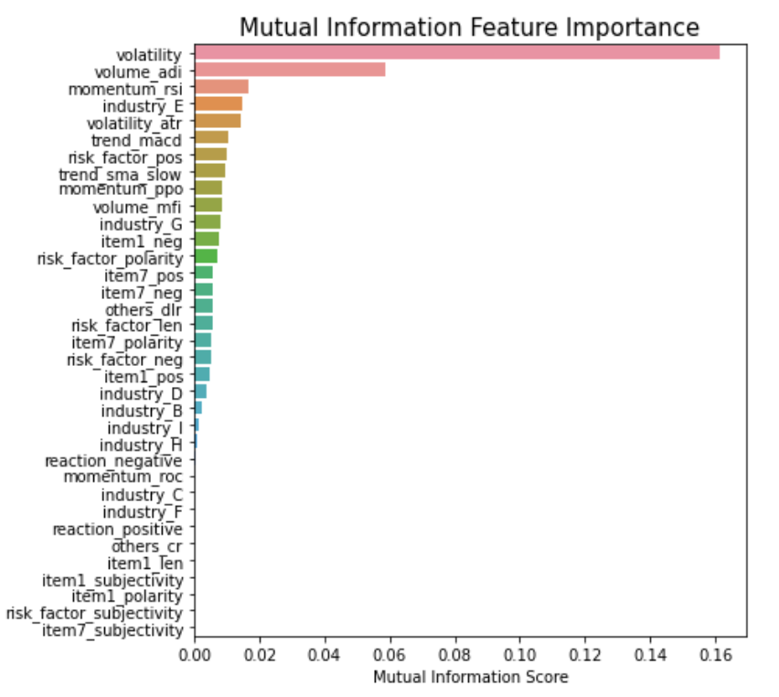
Feature Selection
Importance Visualization
Feature1 | Feature2 | Feature3
Item7_pos | Item1_len | 0.988
Risk_factor_pos | Risk_factor_len | 0.985
Sample Correlated Features
Mutual Information Score
[1] Gupta, “Feature selection techniques in machine learning,” Analytics Vidhya, 2020.

Slide 23
Model & Result
06

Slide 24
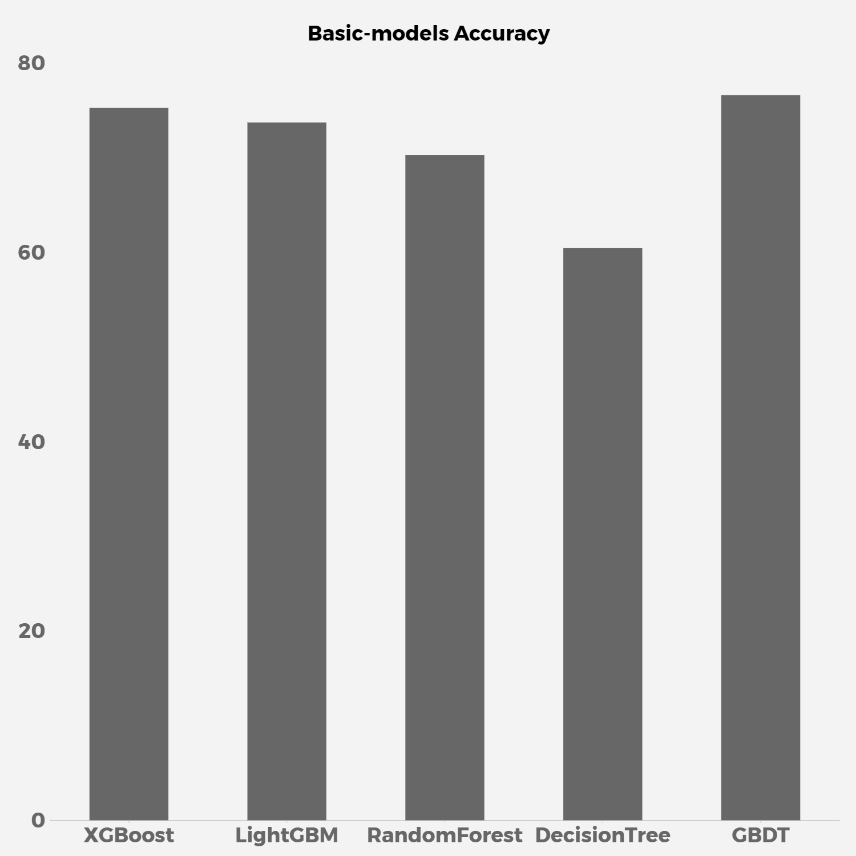
Basic-models Performace
Basic-model | Accuracy
Gradient Boosting Tree | 76.55%
XGBoost | 75.22%
LightGBM | 73.67%
Random Forest | 70.21%
Decision Tree | 60.40%

Slide 25
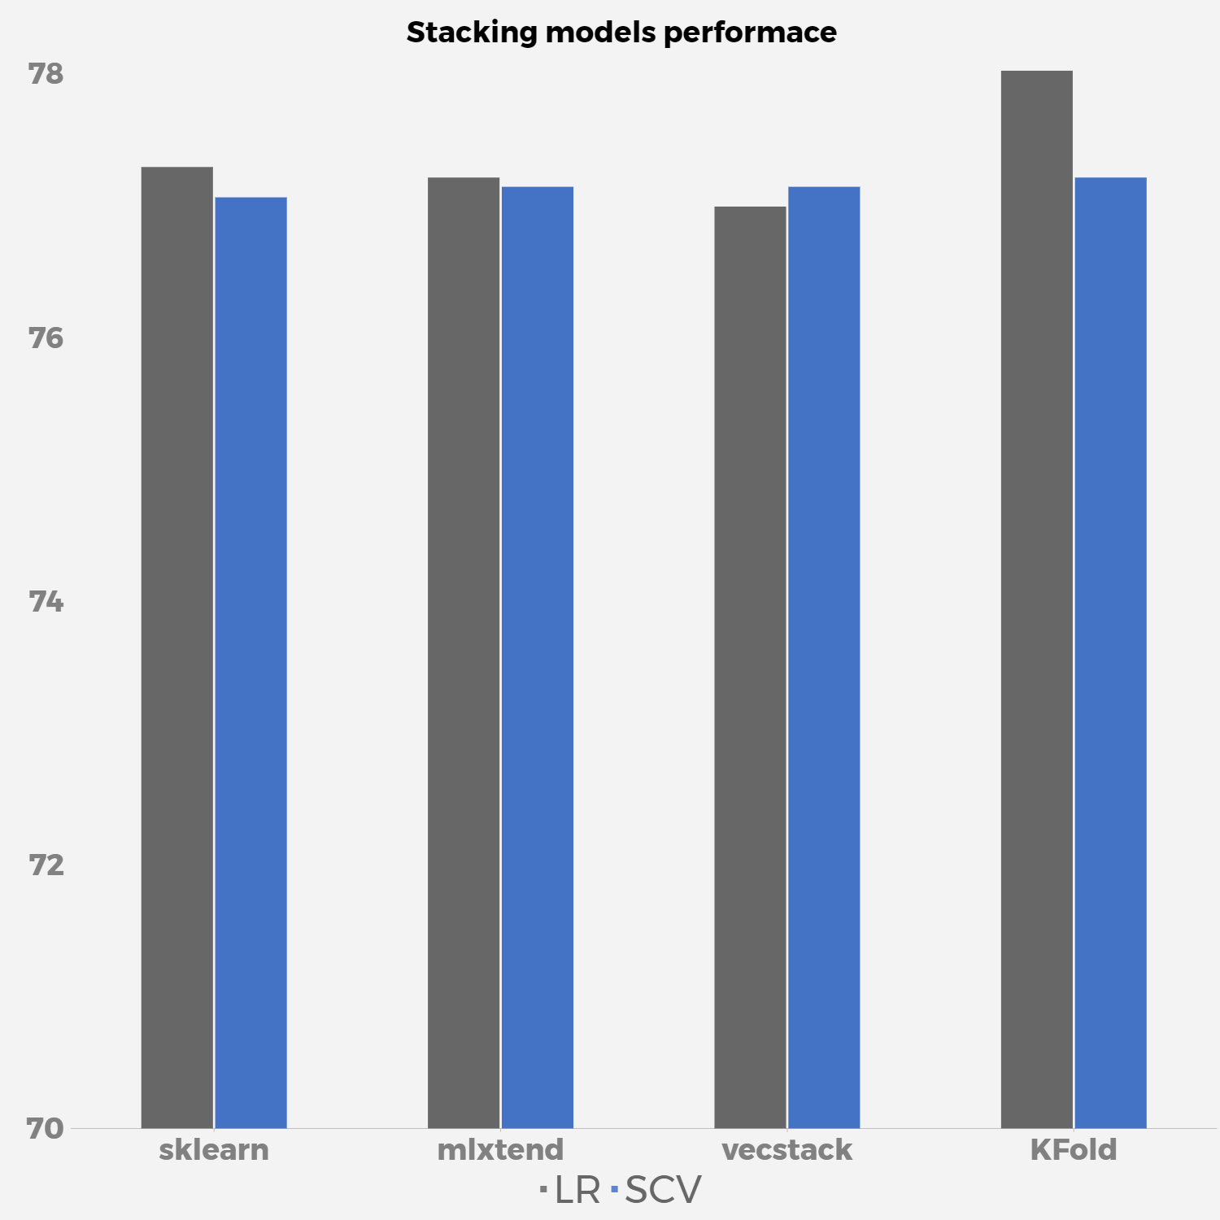
Stacking-models Performace
Random Forest
Gradient Boosting
Data
XGBoost
Logistic Regression
or
SVC
LightGBM
Decision Tree
Type | Model | LR | SVC
Traditional | sklearn | 77.29% | 77.06%
 | mlxtend | 77.21% | 77.14%
 | vecstack | 76.99% | 77.14%
Customized | Kfold Cross-Validation | 78.02% | 77.21%

Slide 26
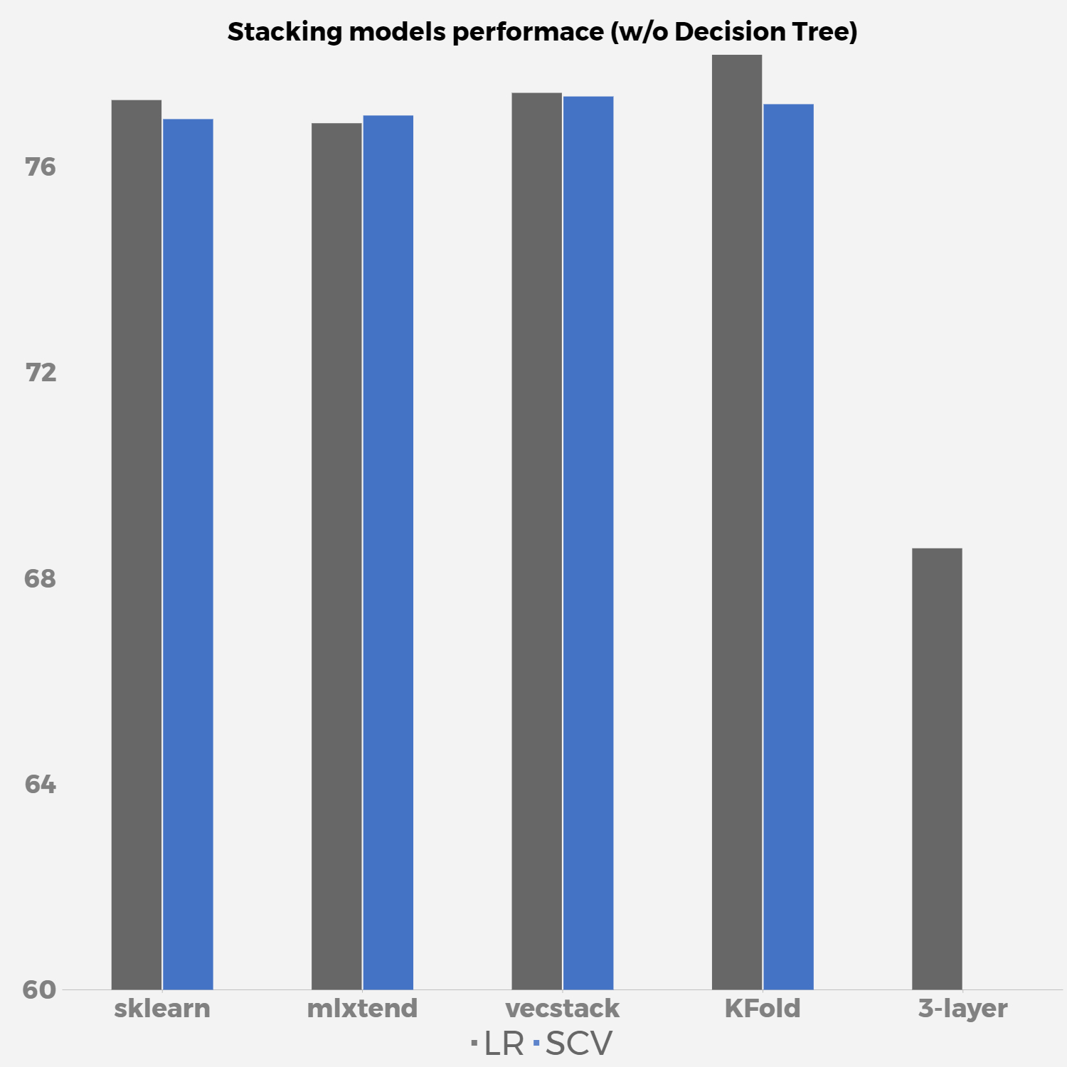
Stacking-models Performace
(w/o Decision Tree)
Random Forest
Gradient Boosting
Data
Logistic Regression
or
SVC
XGBoost
LightGBM
Type | Model | LR | SVC
Traditional | sklearn | 77.29% | 76.92%
 | mlxtend | 76.84% | 76.99%
 | vecstack | 77.43% | 77.36%
Customized | Kfold Cross-Validation | 78.17% | 77.21%
Multi-layer |  | 68.58%

Slide 27
Multi-layer Stack Model Performace
(Accuracy: 68.58%)
Random Forest
SVC
Gradient Boosting
Data
Logistic Regression
XGBoost
Decision Tree
LightGBM

Slide 28
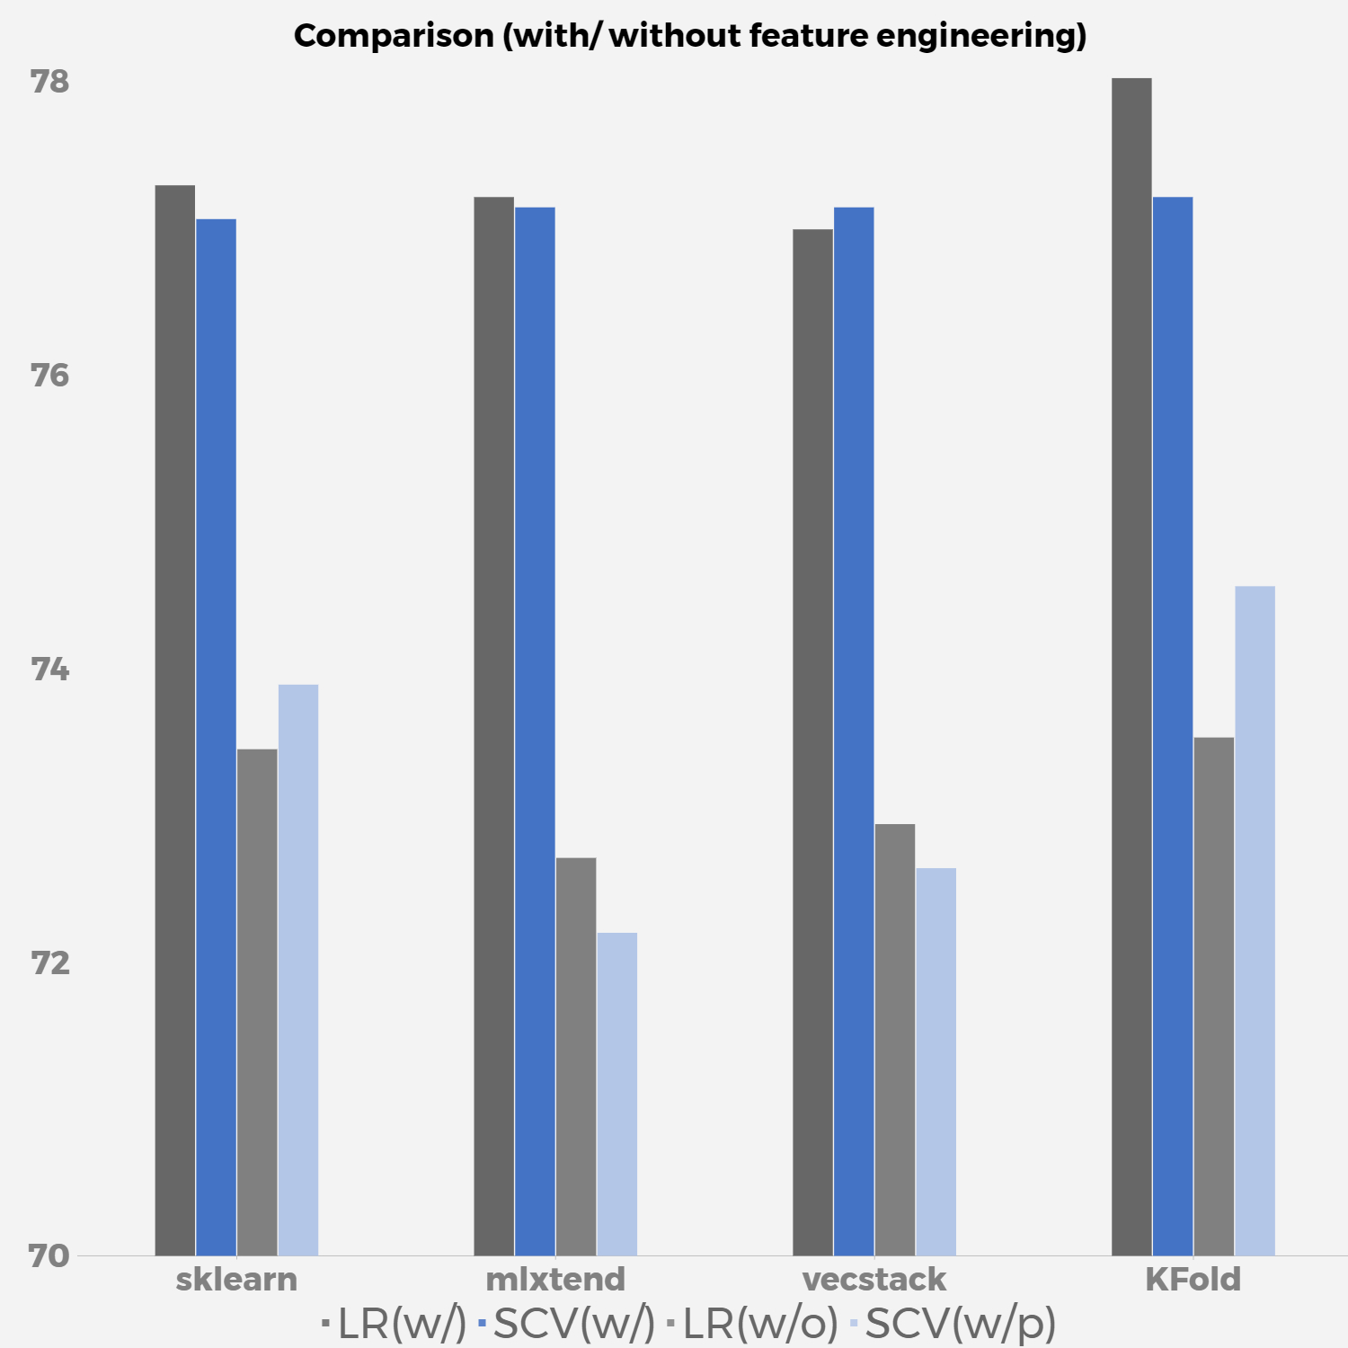
Comparison
(w/o Feature Engineering)
Type | Model | With Feature Engineering |  | Without Feature Engineering
Type | Model | LR | SVC | LR | SVC
Traditional | sklearn | 77.29% | 77.06% | 73.45% | 73.89%
 | mlxtend | 76.84% | 76.99% | 72.71% | 72.20%
 | vecstack | 77.43% | 77.36% | 72.94% | 72.64%
Customized | Kfold Cross-Validation | 78.17% | 77.21% | 73.53% | 74.56%

Slide 29
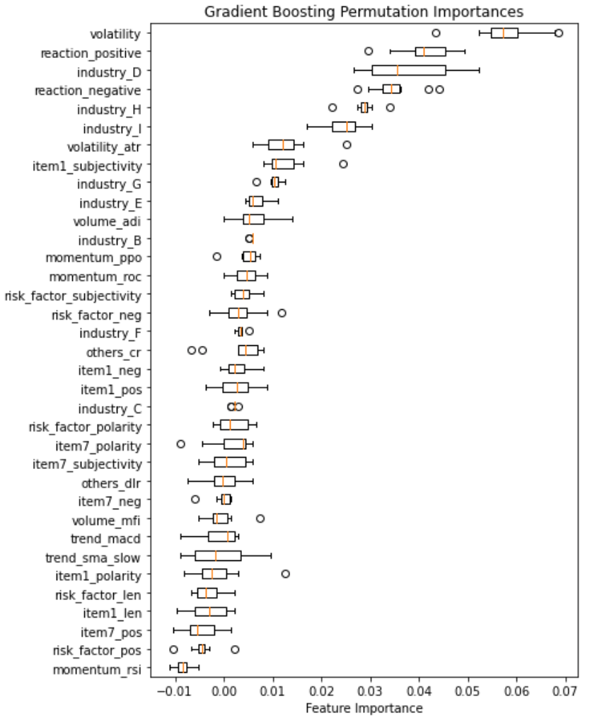
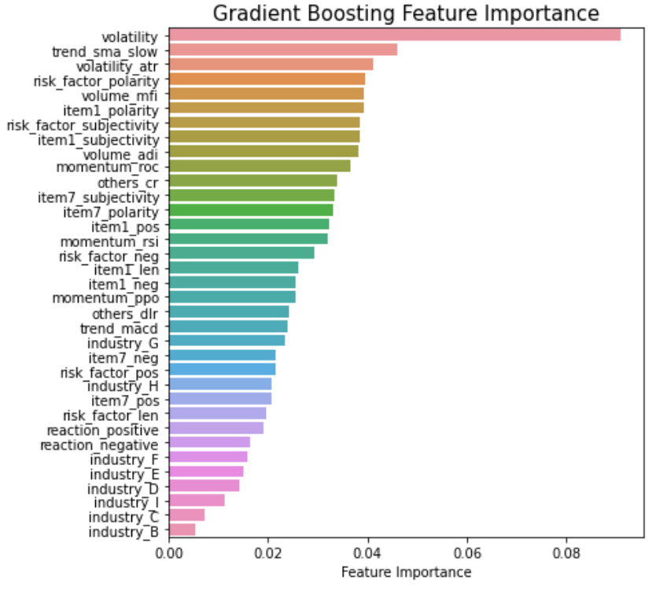
Feature Selection
Importance Visualization
Gradient Boosting (Model Agnostic) Feature Importance
Gradient Boosting Feature Importance
[1] Gupta, “Feature selection techniques in machine learning,” Analytics Vidhya, 2020.

Slide 30
Conclusion
07

Slide 31

Modelling
Feature: Volatility
Feature: Sentiment
Feature: SIC
Conclusion
The model acheives 78% of accuracy
Improve accuracy by 5%
Improve accuracy by 5%
Improve accuracy by 4%

Slide 32

Thanks

